Slide 1
Probabilistic to Quantum Journey
By Talal

Slide 2
Deterministic to Probabilistic
2012 p-bits
Using induced magnets with two directions of magnetization representing 0 and 1
Used in magnetic-core memory
Smaller Magnet → Unstable (keeps switching polarity)
Unstable → Probabilistic
Tohoku (2019)
Circuits vs Magnets (fewer transistors)
Circuits →Pseudo Probabilistic Computing
Notes:
Current computers we are working with are deterministic take addition for example we add two numbers and get a fixed and determined output (Adder)

Slide 3

Computer State
The state of the bits in the system
All possible states form a state space
A path is all transitions from a given initial(input) to a required final state(output)
Each transition has a probability
In a state space multiple paths can exist between any two states hence probabilities are added up to get overall probability of getting to the final state
Max Probability = 1

Slide 4
Quantum State Space
Qubits
Probability Amplitude = Negative Probability
Negative Probability → Complex Numbers
The final probability = |Probability Amplitude| [0 to 1]
Complex → Probability of One Path can decrease Probability of another because of the imaginary parts
This is called Path Cancellation

Slide 5
Algorithms: Path Cancellation
Integer Factorization (Peter Shor)
Search (Lov Grover)
Intermediate Paths leading to wrong outputs cancel each other while those that lead to right output add to each others probability

Slide 6
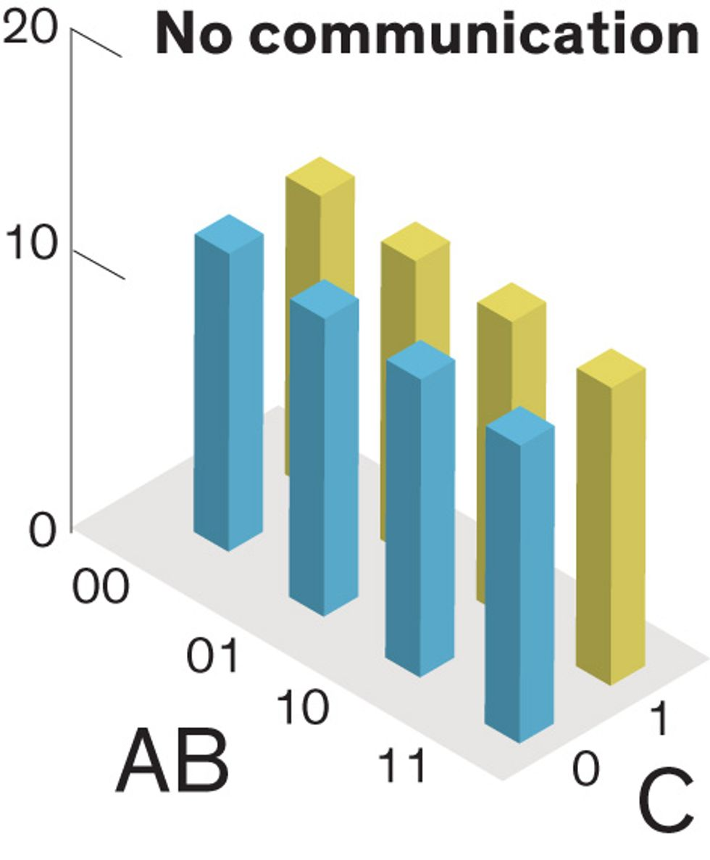
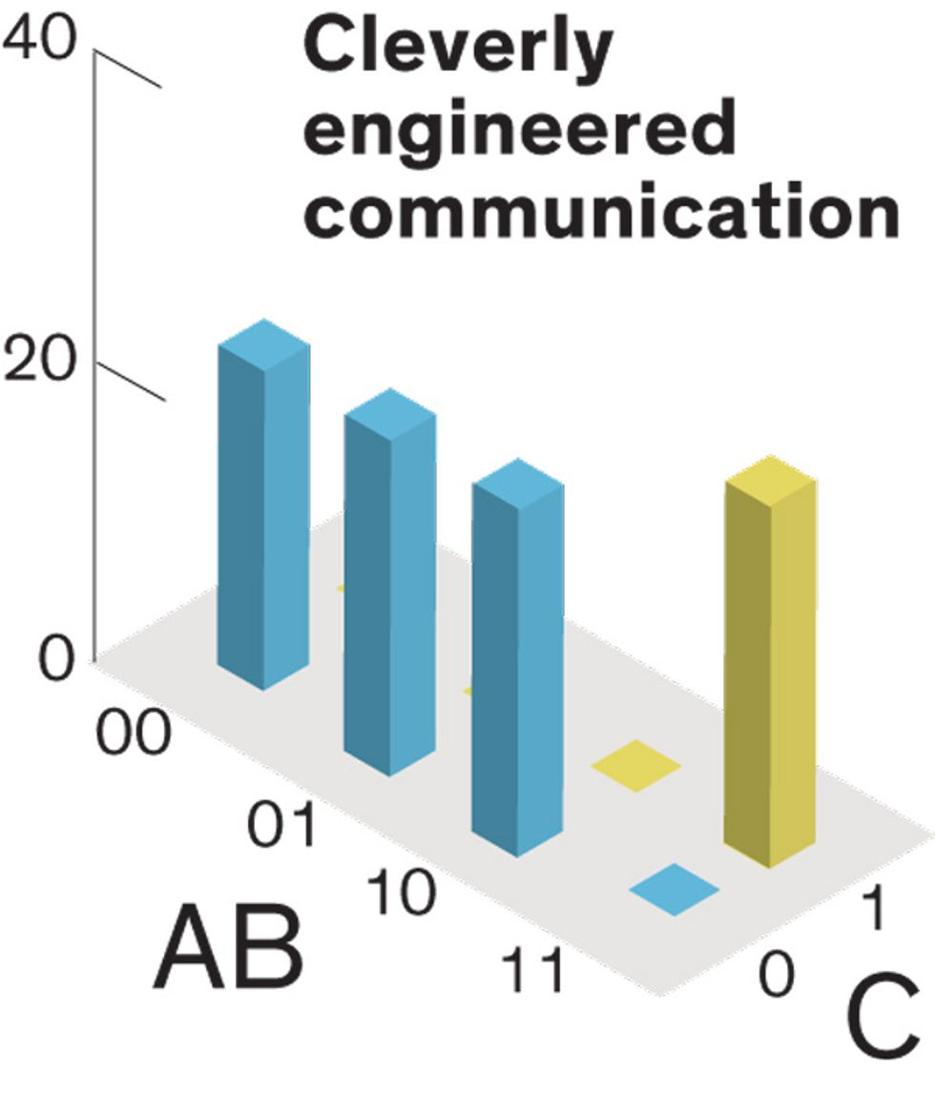
Computing: Probabilistic Approach
Forward Algorithm: A sets B sets C
Default Probabilistic State

Slide 7
Computing: Probabilistic Approach
Inverse Algorithm: C(Output) is 0
Hence AB can be only {00,01,11}
Use Algorithm to find which one is true input using Path Cancelling

Slide 8
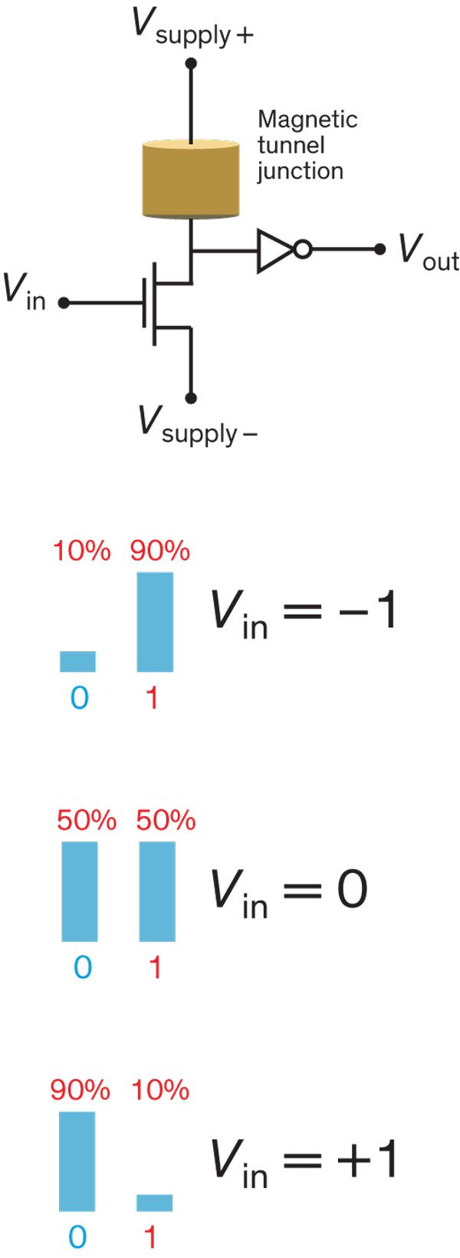
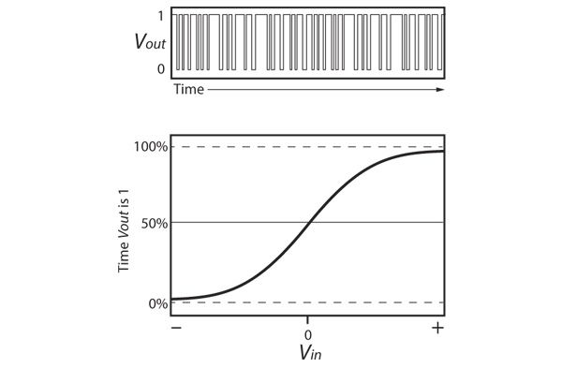
Probabilistic Communication
Vin – Attach input p-bits
Vout – Attach output p-bits
The device allows the ‘fixing’ the probabilities of the input p-bits
Eg: A sets B
A at Vin
Modify p-bit A’s probabilities to fix value
Send Output to change polarity of p-bit B
Probability → Time Spent in 1 or 0 state

